Slide 1

(TIME TO) REACT
LESSON 5
CFGDEGREE → FULL-STACK STREAM

Slide 2

AGENDA
01 Introduction to React
02 React exercises

Slide 3


Introducing React
And how does it relate to all the web development stuff we learnt
At glance
React is a JS Library (a collection of helpful code and routines bundled together)
It can be added to our websites in a scalable way - we can either a little bit of React (e.g. here and there in our HTML site) or make the entire website be React-based instead (discarding the HTML and CSS stack entirely to a degree)
Its purpose - why is it useful, why even care?
React is all about creating and using ‘components’ - self contained elements that we manually create through code
For example, we can create a new button ourselves that fits our vision of what it should be (e.g. perhaps we need some specific design). React allows us to contain all of this code into one ‘button’ component (like a object) that can be deployed over and over again (making it incredibly easy for us to be consistent).
React’s second benefit is its virtual DOM. Effectively it keeps a 2nd copy of our DOM which is updated when we make changes, and publishes / pushes this changes into the real DOM when its ready. The benefit of this is speed - instead of reloading a page 5 times, React will often batch new changes itself so the entirety of the real DOM doesn’t have to reload or change

Slide 4
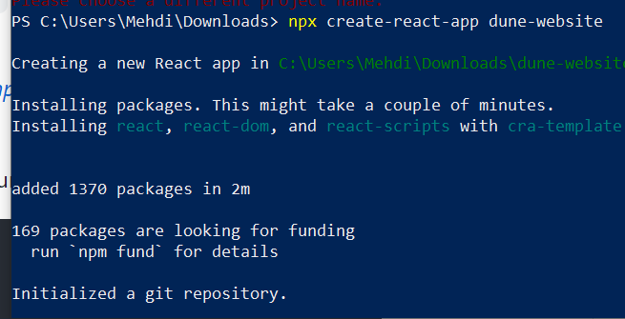
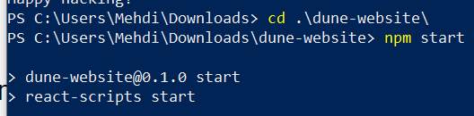
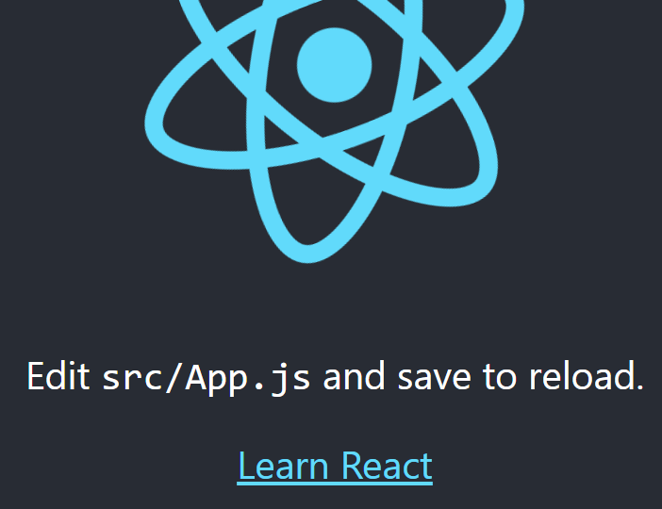
Walkthrough: Working with React
We’ll create a simple page via create-react-app
Using your console, navigate to a new folder location - we’ll use a new place and create a new project there
In this location run the command:
npx create-react-app {your project name here}
This will create a new app with the name you specified above! Note that we can always add React partially to our normal websites - but for the sake of time + learning, we’re diving deep into making a full-React app. Feel free to practice and apply what we learn to last weeks HTML + CSS website stack though!
The process takes several minutes - once its created, cd into the folder and run it via npm start!

Slide 5
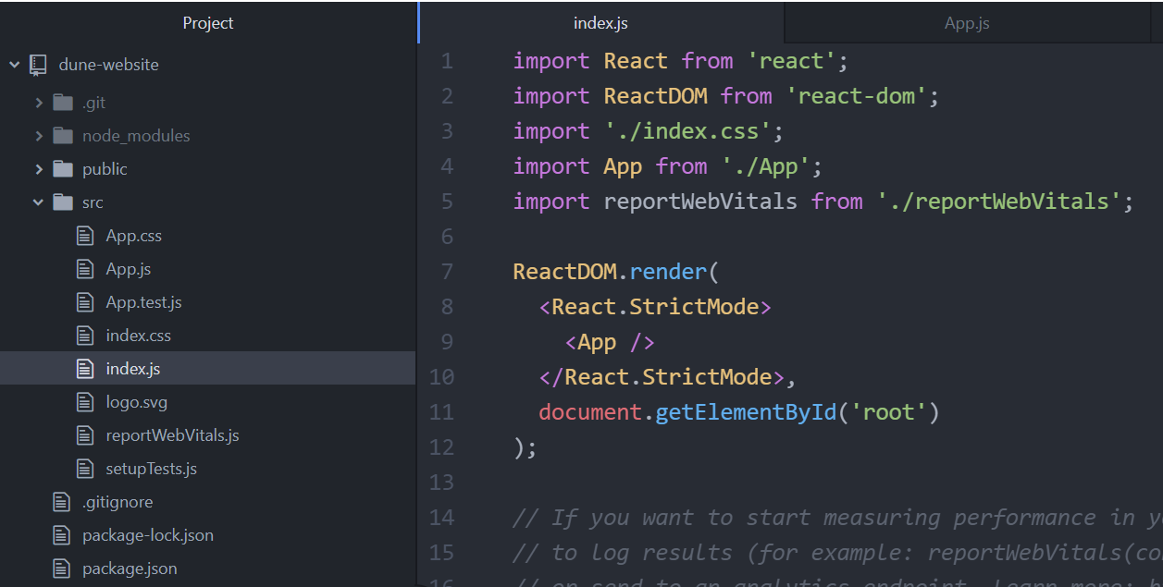
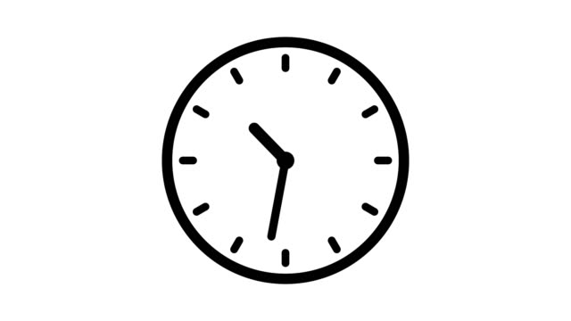
Exercise: Inspect, what’s going on?
Spend several minutes to understand the file structure!
Task 1:
Consider the similarities with HTML tags, particularly how some parts are structured in these <></> brackets
Task 2:
Consider what is ReactDOM! And what happens if we remove <App />. Think back to the <body> tag
Task 3:
Look into the imported App file (App.js) - what’s inside it? What happens if you change stuff? What’s ‘App.css’ as well?
You have approx. 10 minutes for this (depending on your instructor's discretion + current time!). Google when you can!

Slide 6
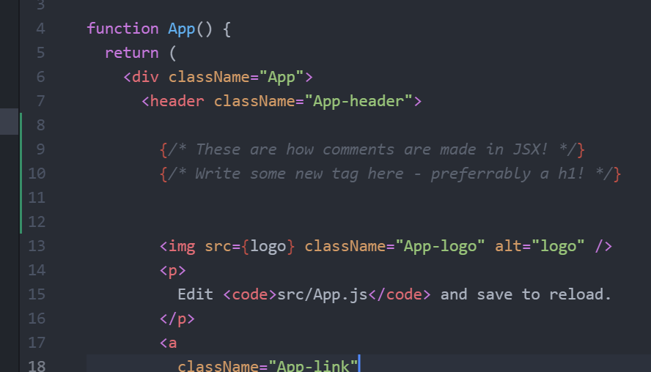
Exercise 2: Modifying our website
Modify your App.js to have new content! Just like we did in L1 for HTML!
Using the following tags….
<h1> (or h2, h3, …, h5, h6), <p>
……add the following information to your website:
Your favourite hobby or activity you like to do (e.g. for downtime)
Any relevant rules (e.g. how to play if its a sport hobby)
Why do you do it, why do you enjoy it
Effectively your hobby 101 website
Use a combination of tags: you must have at least one of headings + paragraph tags
(Remember - you can google throughout!)
You have approx. 8 minutes for this (depending on your instructor's discretion + current time!). Google when you can!

Slide 7
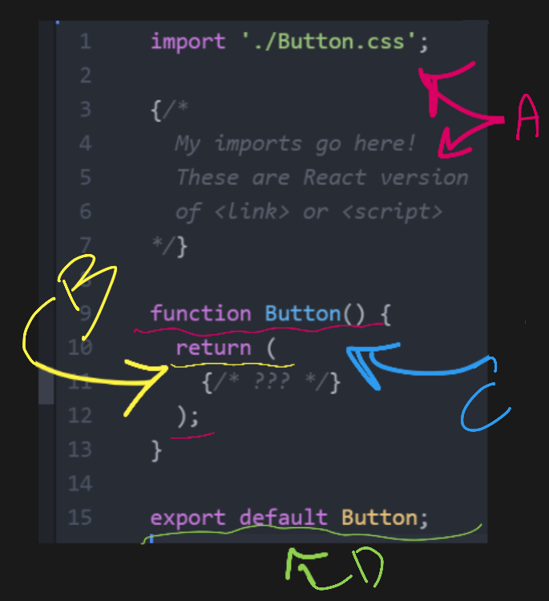
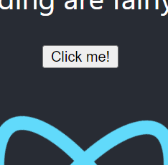
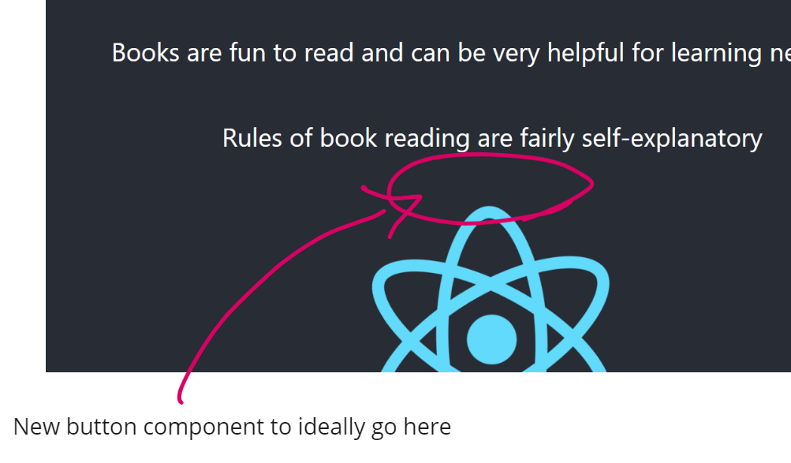
Walkthrough: Creating our first component
We’ll create our own custom button this time, together with your instructor
Create a new file called Button.js - we’ll write our component code in here
Write this boilerplate in it below! Your instructor will explain what each part does (e.g. A, B, C and D on the right)
You’ll need to import your new component into App.js afterwards as a heads up in order for it to be visible!
# SKETCH OF WHERE BUTTON SHOULD GO
# EXAMPLE OUTPUT

Slide 8
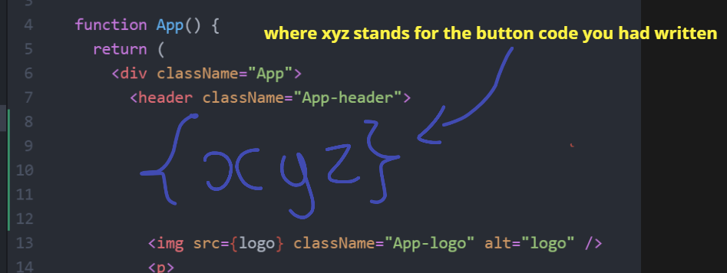
Exercise 3: Beautify your component
Make your button look shiny and nice!
Making use of a separate CSS file, apply the following effects to your new button:
Text should be bolded and in a different font color (any is fine)
Button itself should be light blue
Button should have a thin border surrounding it (any thickness, any color)
Increase its font size (any is fine)
Increase the space between the actual button text and the border!
Note that some CSS selectors are different this time (e.g. class keyword!).
You have approx. 14 minutes for this (depending on your instructor's discretion + current time!). Google when you can!

Slide 9
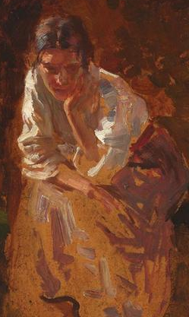
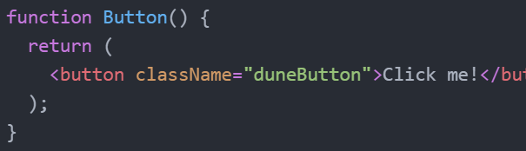
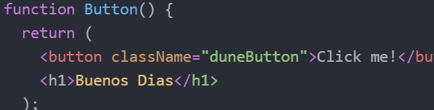
Exercise 4: Play around & cause errors
Your code likely just returns 1 button - what if we try to return another element with it too?
# PONDER & THINK!
Your code may look like this at the moment - just a component file that returns a button for App.js (or whoever is above it in terms of hierarchy) to render
What happens if you try say, returning a button and another element e.g. a p tag like this?
What happens? If its an error, how can you fix it? Your instructor can discuss these solutions after a few minutes
<div> or other similar wrappers! Or for extra fancy, React fragments
(Potential?) solutions can be revealed after a click
You have approx. 7 minutes for this (depending on your instructor's discretion + current time!). Google when you can!

Slide 10
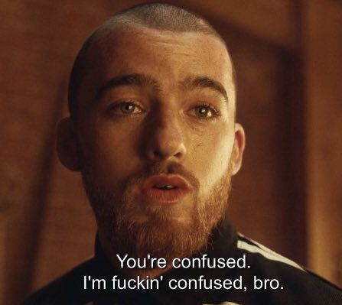
SUMMARY
React can be confusing for everyone - remember that it is effectively JSX (combo of HTML + JS) and all it allows you to do is create replicable ‘components’ (more web dev customizability than standard HTML + CSS).
These components can be imported and repeated again and again - much easier to customise and repeat 1 component (a ButtonComponent.js) than writing its CSS rules and re-checking its consistency across x repeats.
Essentially, all our concerns are encapsulated and abstracted behind one file only

Slide 11
THANK YOU!

